Slide 1
In the Neighborhood
Basic 10 Unit 5b Reading

Slide 2
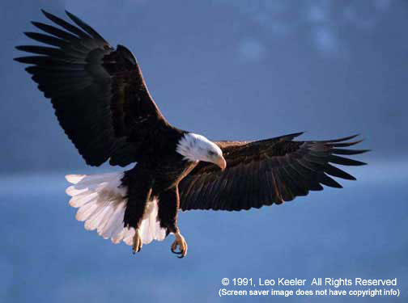
Eagle

Slide 3
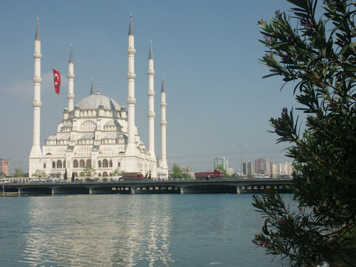
Mosque - Muslim

Slide 4
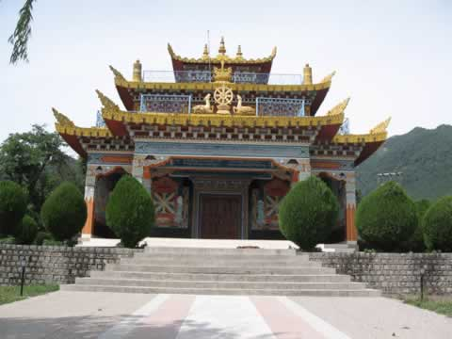
Buddhist temple - Buddhist

Slide 5
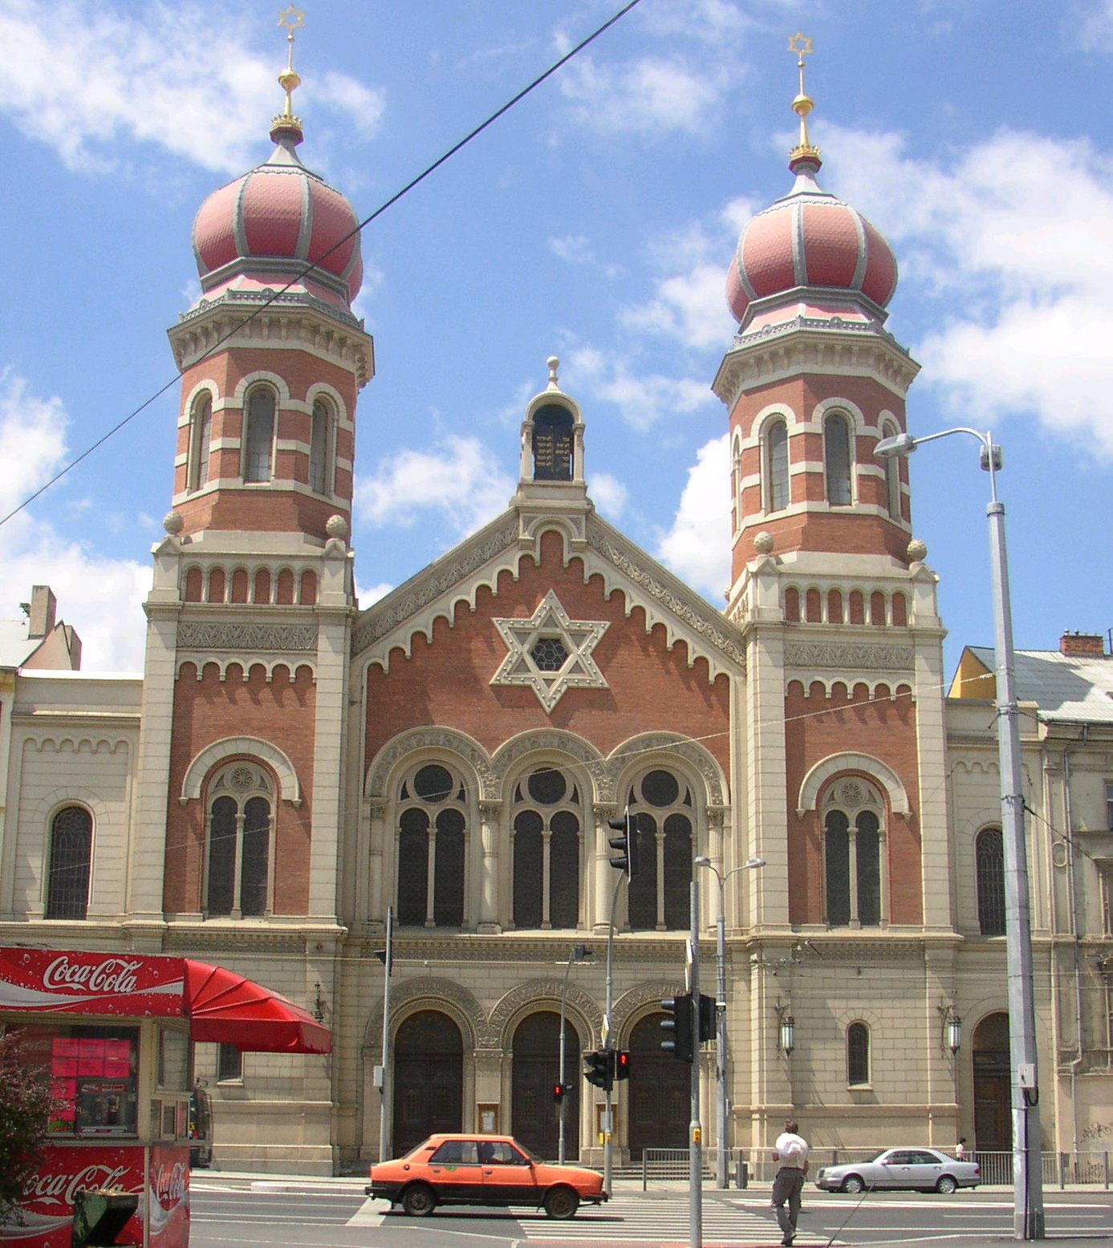
Synagogue - Jews

Slide 6
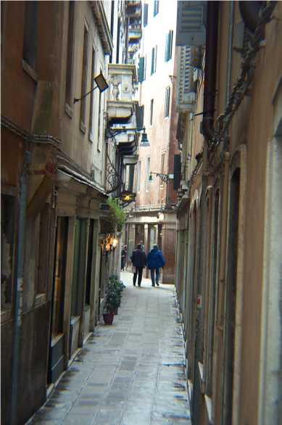
Narrow street

Slide 7
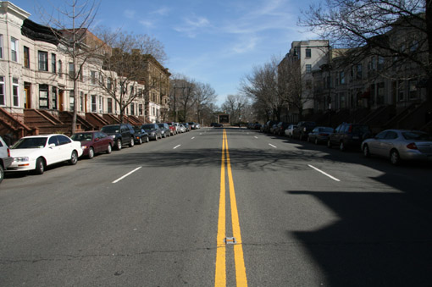
Wide street

Slide 8
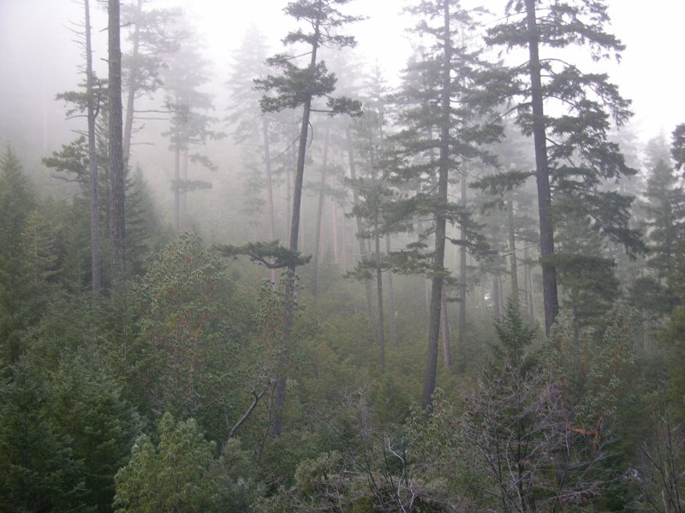
An old forest

Slide 9
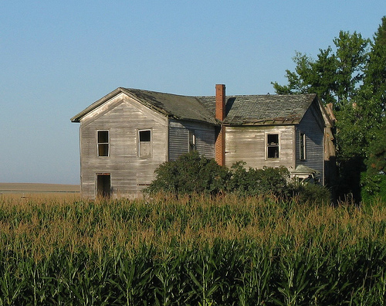
An old farmhouse

Slide 10
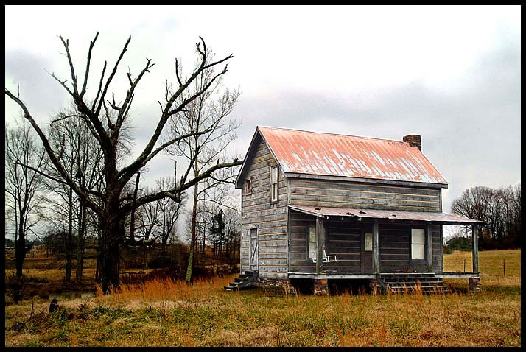
An old farmhouse

